Slide 1
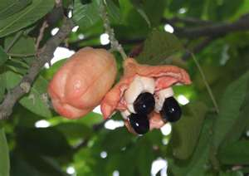
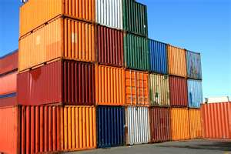

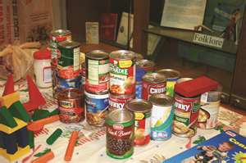
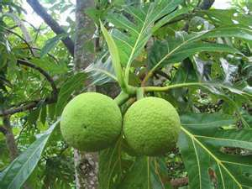
Step by step guide to Export- Testing Export Products for Market Compliance

Slide 2
Ministry of Industry, Investment, Commerce, Agriculture & Fisheries (MICAF)
The Bureau of Standards administers three (3) Acts:
The Processed Food Act 1959
The Standards Act 1968
The Weights and Measures Act 1976

Slide 3
Definitions
Prescribed food: means any food that is manufactured or processed for export or for sale and for which grades or standards have been prescribed.
Accreditation means that the certification body meets the requirements of a national or an international standard as assessed by an accrediting agency.
Testing: evaluation to determine compliance with a specification.

Slide 4
Standards used by the Food Inspectorate Department (some)
JS 276:2016 Jamaican Standard Specification for Processed Ackee
JS 261: 1998 Jamaican Standard Specification for Jams, jellies and marmalade
JS CRS 35:2010 Jamaican Standard Specification for Spices and sauces
JS CRS 25:2008 Jamaican Standard Specification for Rum

Slide 5

LIST OF PRESCRIBED FOODS
(UNDER THE PROCESSED FOOD ACT 1959)
Grapefruit Segments (whole and broken)
Grapefruit Juice (straight and concentrate)
Canned Mango (slices)
Mango with Rum
Marmalade (Orange)
Canned Orange Juice (straight and concentrate)
Canned Pineapple (slices and chunks)
Pineapple Juice
Tomato in skin
Canned Tomatoes
Tomato Juice
Tomato Juice Cocktail
Tomato Ketchup
Canned Yams
Canned Ackees
Jellies
Jams
Guava Cups
Guava Halves
Fruit Nectars
Sauces
Hot Sauce
Hot Pepper Sauce
Table Sauce
Soya Sauce
etc.
Pickled Cucumbers
Susumber
Canned Soups

Slide 6
LIST OF PRESCRIBED FOODS
(UNDER THE PROCESSED FOOD ACT 1959)
Guava Cups
Guava Halves
Fruit Nectars
Sauces
Hot Sauce
Hot Pepper Sauce
Table Sauce
Soya Sauce
etc.
Pickled Cucumbers
Susumber
Canned Soups
Syrups
Processed Meats -
Viennas
- Hams
- Bacon
- Frankfurters
- Bologna
- Salami
Curried Mutton (frozen)
Macaroni & Mince
Mackerel & Bananas
Sweet Potato Mix
Rice & Peas
Fried Plantain
Oxtail in Wine
Stewed Beef
Stew Peas
Chicken (Maryland Style)
Beef Balls

Slide 7
Considerations
Compliance with regulatory bodies
Product history
Importing country requirements

Slide 8


Questions

Slide 9
Thank You

